Slide 1
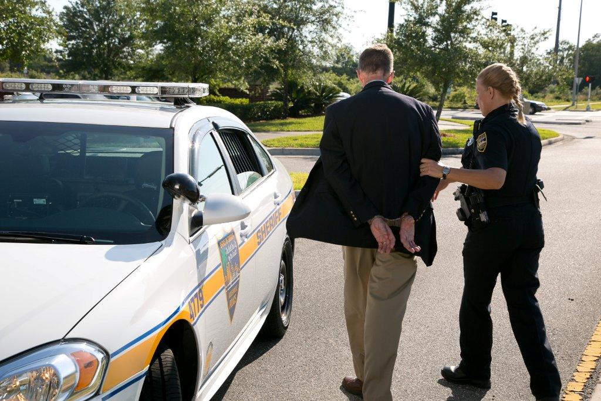



Session 11
Processing the Arrested Subject, Report Writing, and Preparation for Trial

Slide 2

Learning Objectives
  Discuss importance of correct processing and report writing procedures in DWI arrests
  Discuss correct sequence of DWI processing procedures

Slide 3
Learning Objectives
  Discuss the essential elements of a DWI report
  Successfully complete a narrative arrest report
  Discuss the importance of trial preparation

Slide 4

Foundation for Successful Testimony
  Relationship between law enforcement officer(s) involved with arrest and prosecuting attorney(s)
  Effective communication and a clear understanding

Slide 5
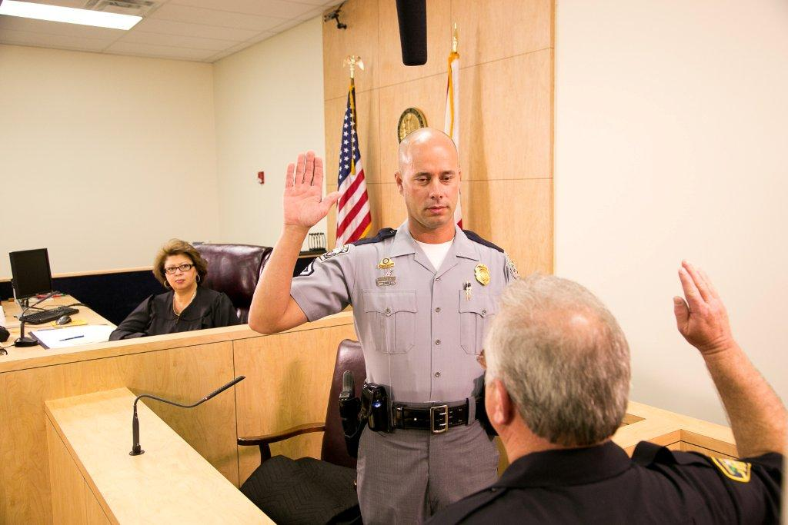
Testimony
  Be prepared to speak to evidence
  Take time
  Listen
  Organize response before answering questions

Slide 6
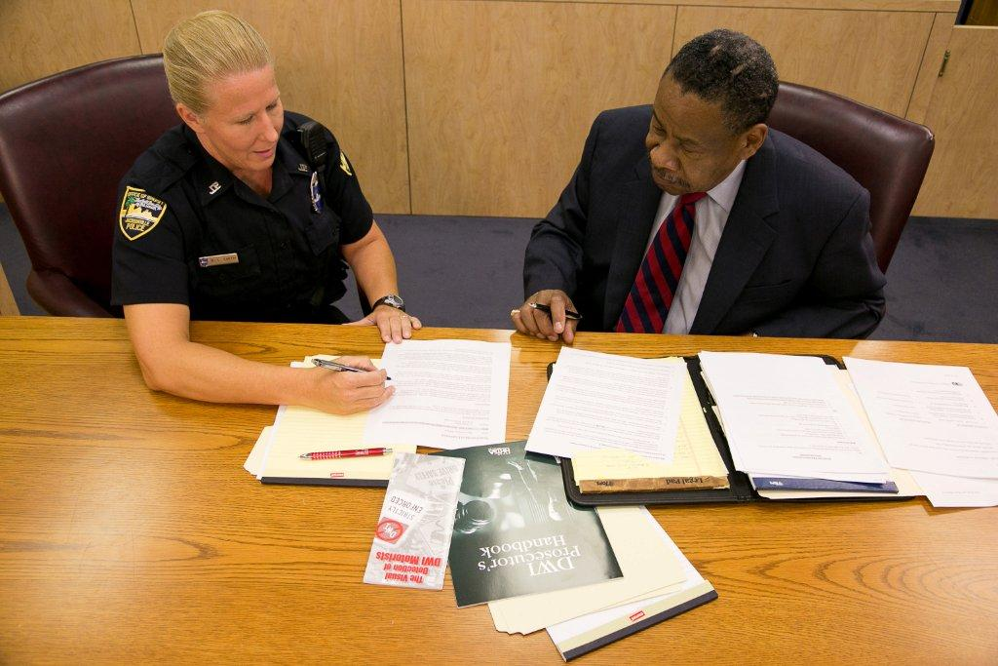
Successful Prosecution
  Organize and present relevant evidence
  All evidence must be compiled during three phases of detection

Slide 7
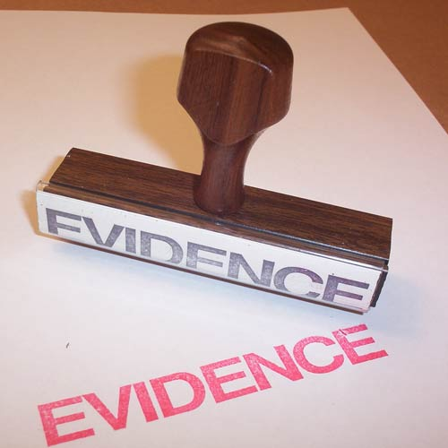
Types of Evidence
Physical
Established facts
Illustrative
Demonstrative
Written documentation
Testimony

Slide 8
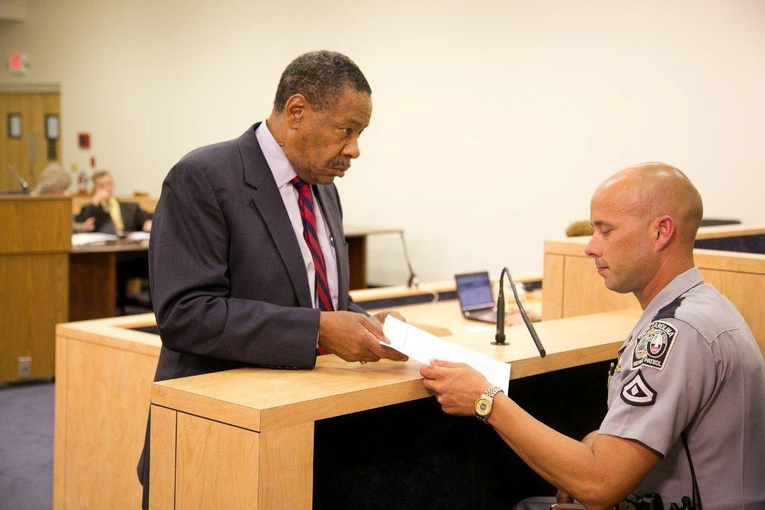
Prosecutor
Prove every element
of offense
Establish proper procedures were followed

Slide 9
Proper Arrest Procedures
Miranda warning
Subsequent observations/interview of defendant
Chemical test

Slide 10

Guidelines for Note Taking
Recognition and retention of facts
Must establish each element of violation
Recognize and recall facts and circumstances
Rely on your own field notes

Slide 11
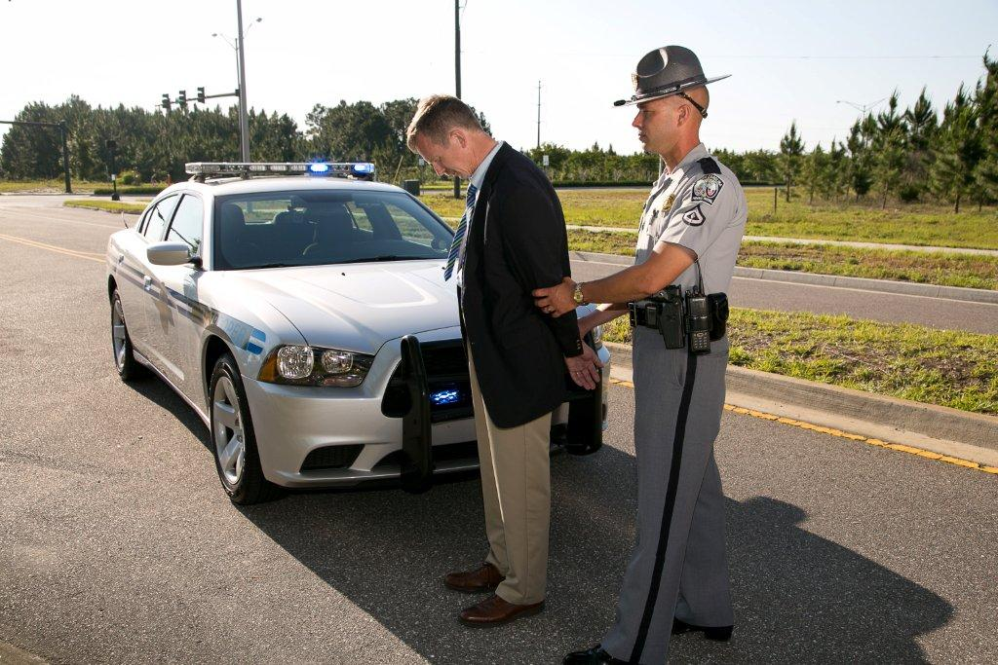
Processing Tasks

Slide 12
Essentials of Prosecution’s Case
Reasonable suspicion for contact
Probable cause for arrest
Proper arrest procedures
Post-arrest evidence
Request for chemical test(s)/results
Clear and concise report

Slide 13
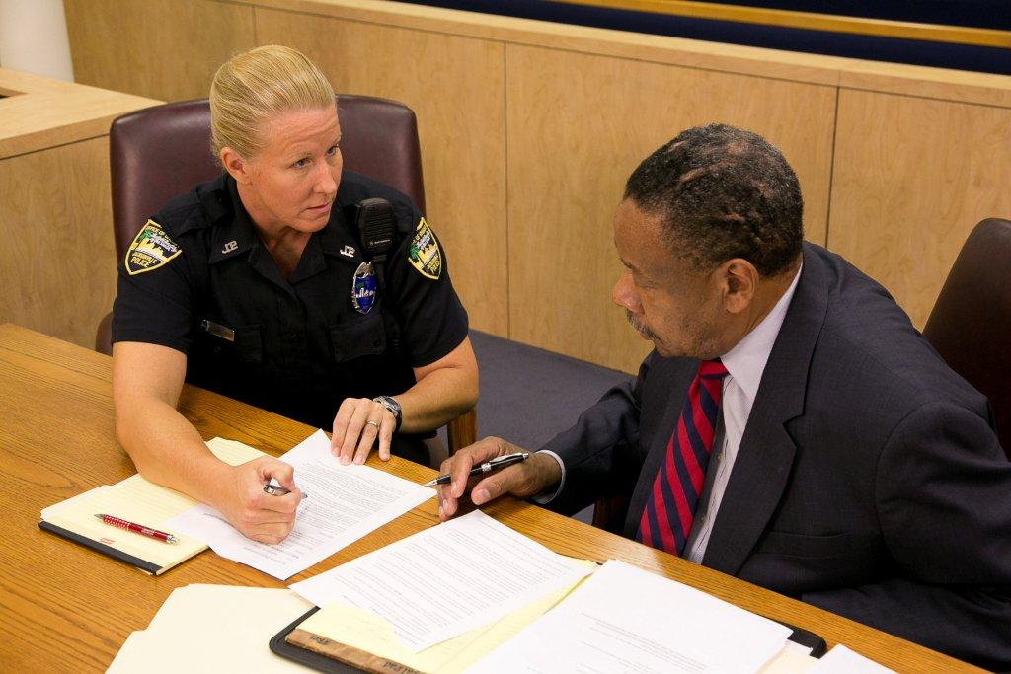
Detection and Arrest
Mentally note relevant facts
Field notes
Follow departmental policies

Slide 14

Writing the Report –
Vehicle in Motion
Initial Observations
Driving or Actual Physical Control
Vehicle Stop

Slide 15
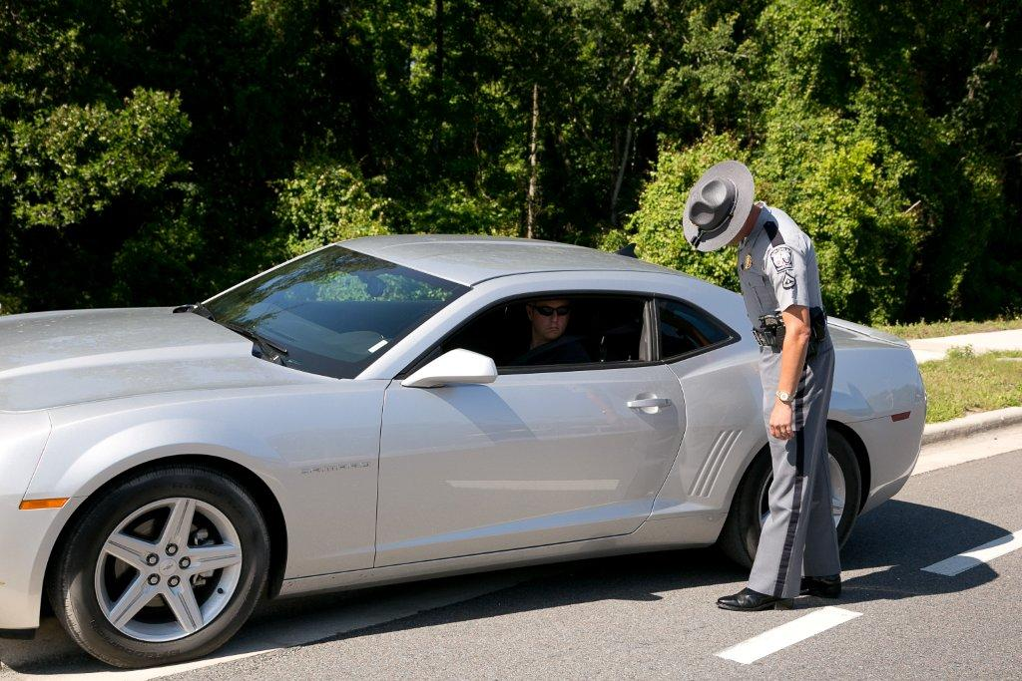
Writing the Report –
Personal Contact
Contact With Driver
Preliminary Questions
Exit From Vehicle

Slide 16
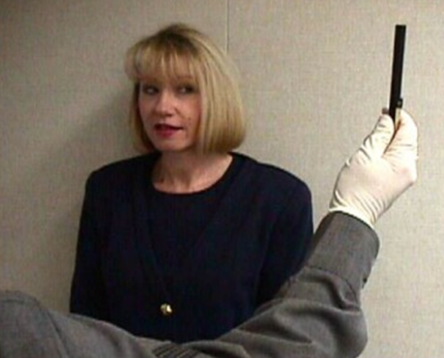
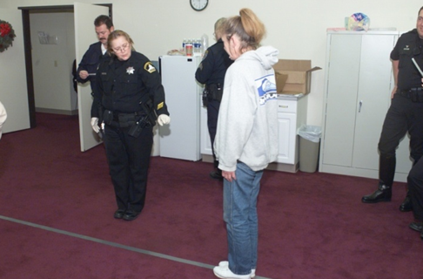
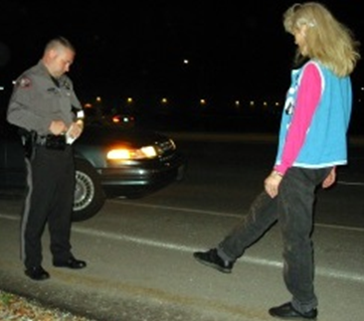
Writing the Report –
Pre-Arrest Screening
SFSTs
Other Field Sobriety Tests
Arrest

Slide 17
Writing the Report –
Post Arrest
ON SCENE:
Disposition of Passengers
Disposition of Vehicle and Property
Witness’ Statements
Transport of Defendant

Slide 18
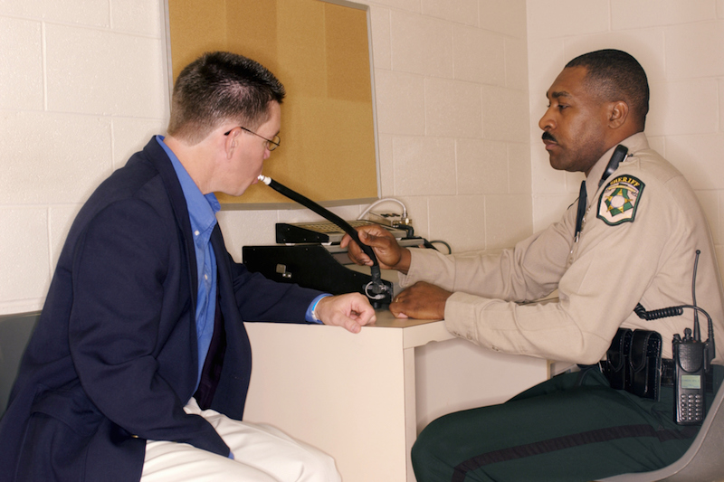
Writing the Report –
Post Arrest
POST SCENE:
Implied Consent/Search Warrant
Miranda Warning
Evidentiary Test(s)
Notifications
Citation/Complaint
Book or Release

Slide 19
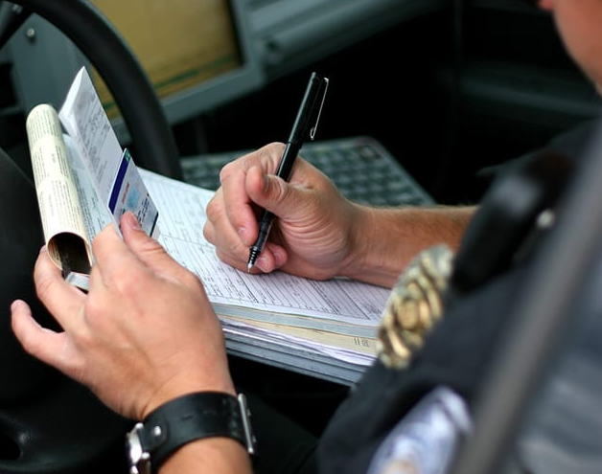
Writing the Report
Narrative must be detailed and accurate
Successful prosecution depends on your ability to describe events observed

Slide 20

Nighttime DWI Arrest

Slide 21
DWI Incident Report
Defendant: Jarod Primo Age:31
Date of Arrest: XX/XX/XX
Time of Arrest: 9:20 PM
Initial Observation:
  Defendant driving white SUV
  Driving without license plate
  Drifted over the center line twice

Slide 22
DWI Incident Report
Initial Observation:
  Weaving within lane
  Four lane roadway, clear, breezy, traffic light
  Slow response to stop command
  Crossed over fog line
  Failed to use turn signal
  Failed to stop at stop sign

Slide 23
DWI Incident Report
Contact with Driver
Driver was sole occupant
Produced credit card instead of DL
Forgot to produce registration/insurance
Odor of alcoholic beverage in vehicle
Admissions of drinking
Unsteady on exit from vehicle

Slide 24
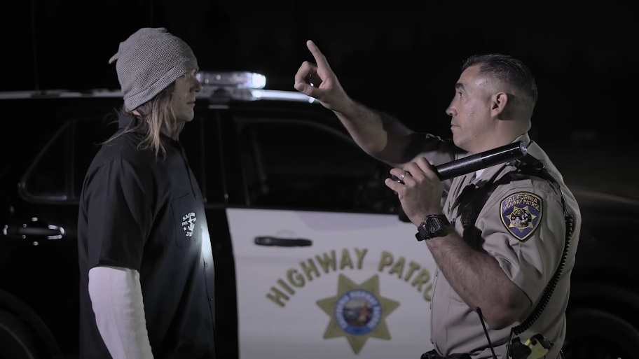
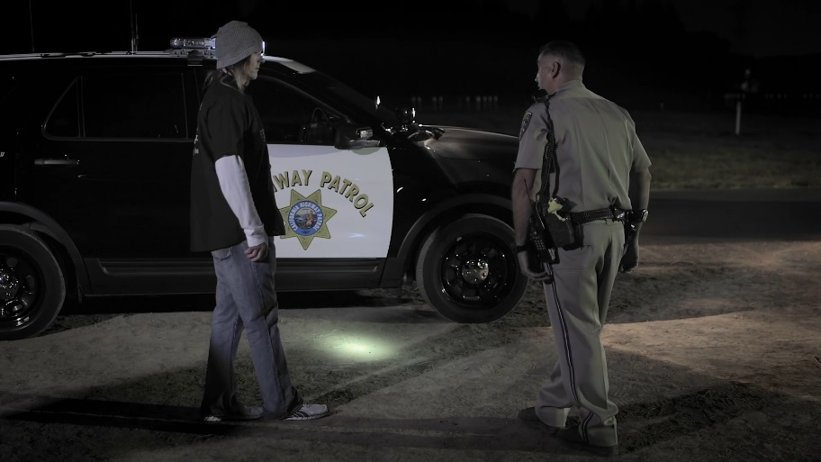
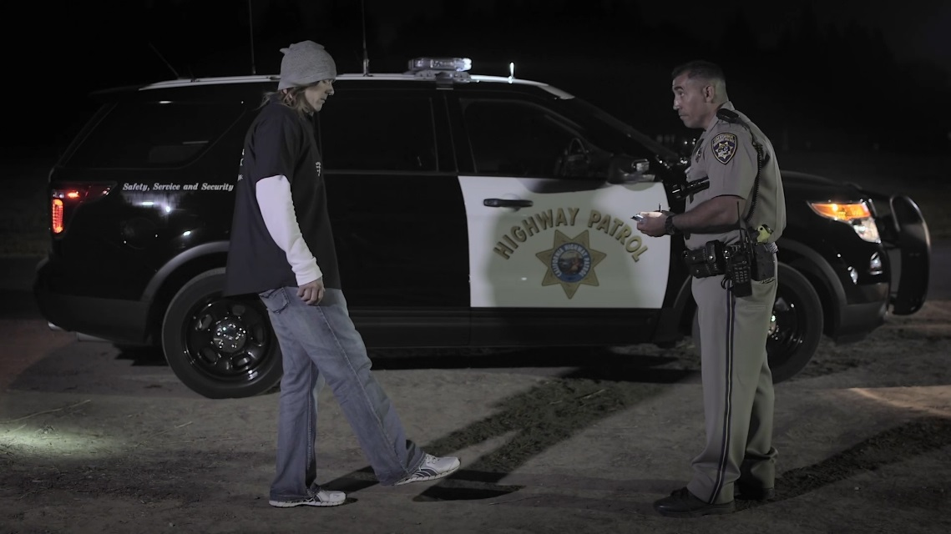
SFSTs

Slide 25
The Arrest
Based on observations of defendant’s driving,
physical appearance, and performance of SFSTs,
she was placed under arrest for DWI.

Slide 26
Case Preparation
Use field notes to document evidence
Accurately note statements and other observations
Review case with other officers
Collect and preserve evidence
Prepare required documents

Slide 27
Report Consistency
Adequately explain inconsistencies
Review records and reports
Properly document evidence

Slide 28
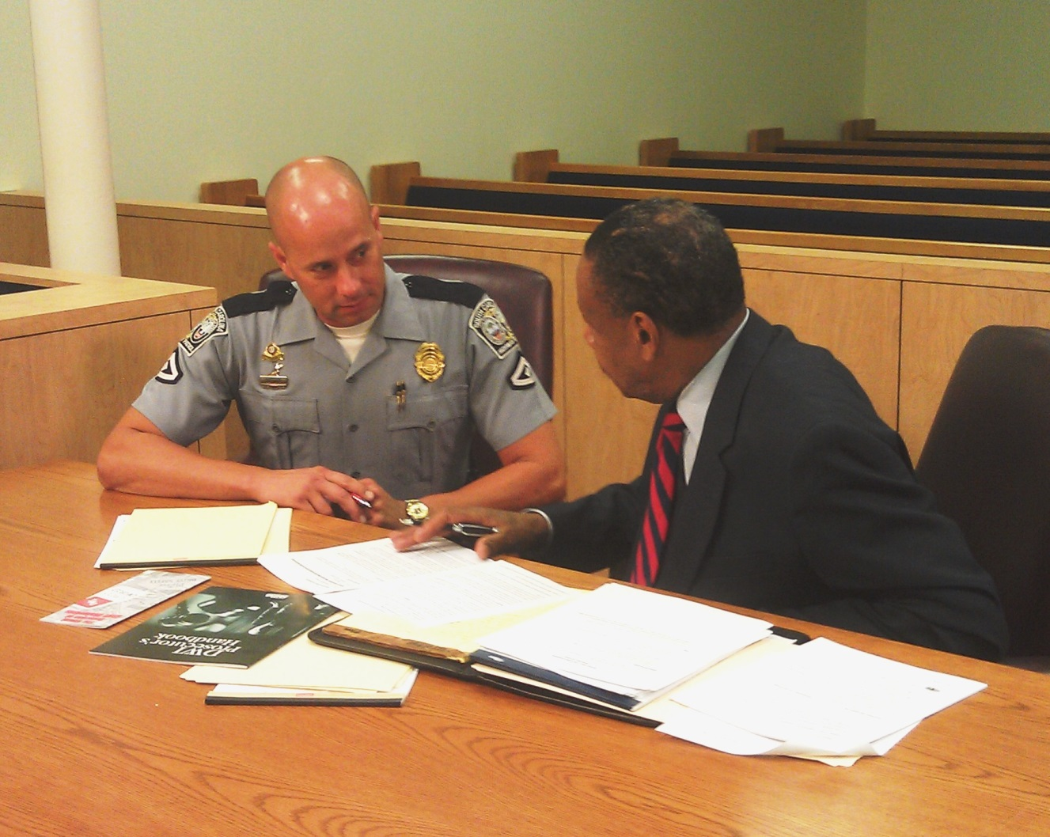
Pretrial Conference

Slide 29
Pretrial Conference
Be prepared
Discuss all evidence/conclusions
Identify strengths and issues
Review potential questions
Identify defense challenges

Slide 30
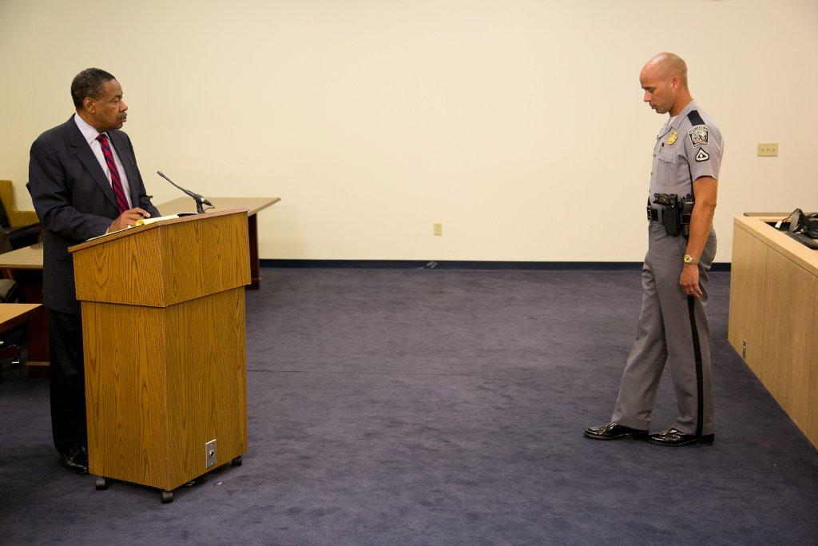
Direct Testimony
Describe in detail case facts, all observations, SFSTs clues/observations
Be professional
Use plain language
Make eye contact with judge/jury
Repeat important points

Slide 31
Cross Examination
Be polite
Don’t become agitated
If you don’t know the answer
  Don’t guess
  “I don’t know”

Slide 32

Defense Challenges
Your observations/interpretations
Your credentials

Slide 33
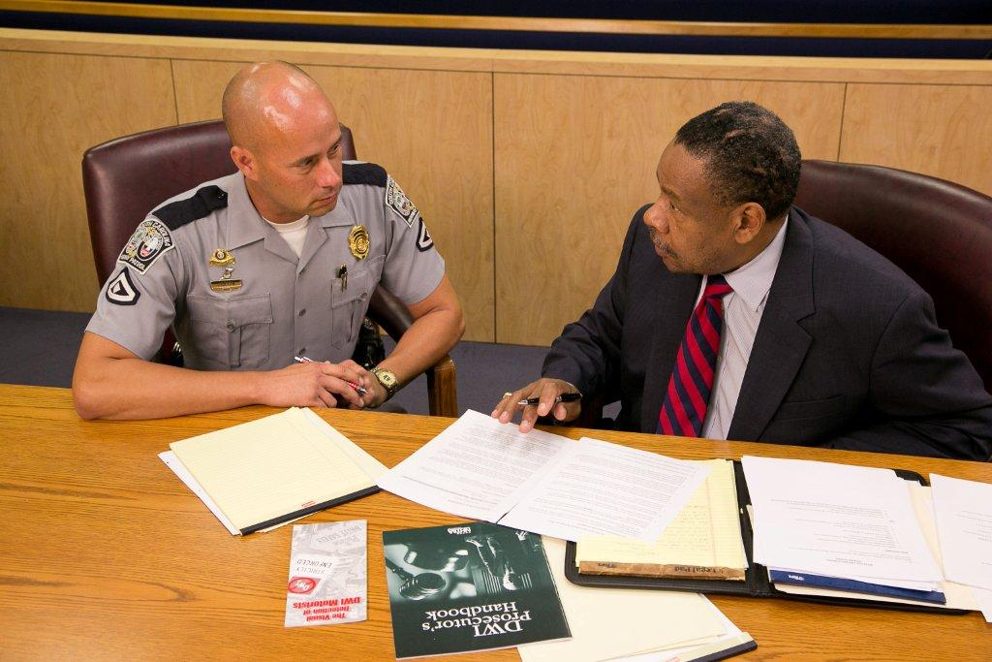
Defense Challenges
Your credibility
SFSTs

Slide 34
Questions?

